Slide 1
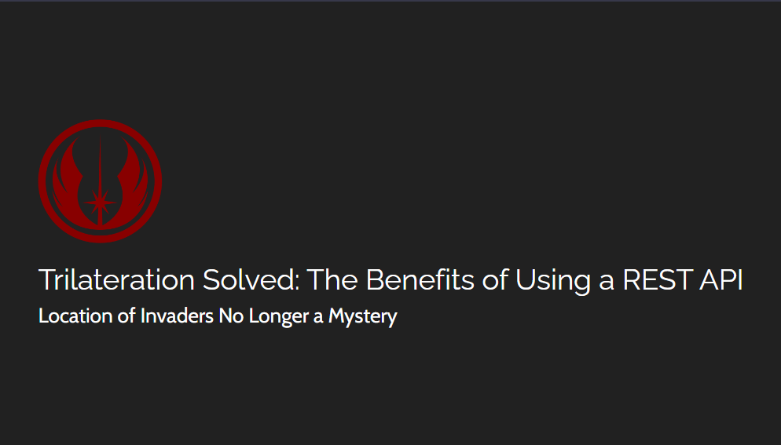

Slide 2
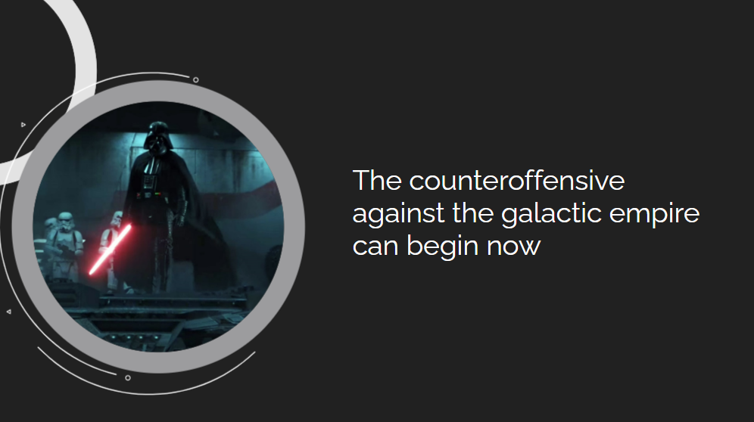

Slide 3


Slide 4
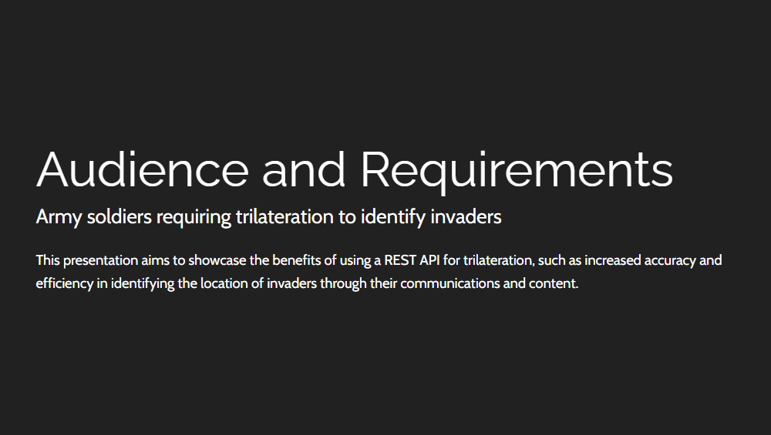

Slide 5
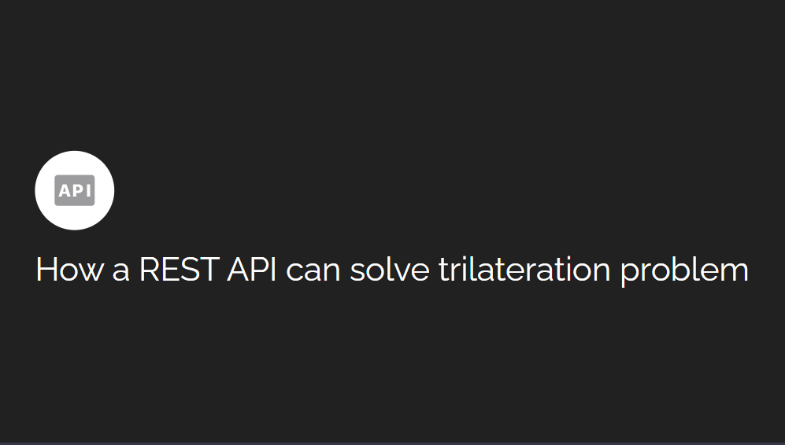

Slide 6
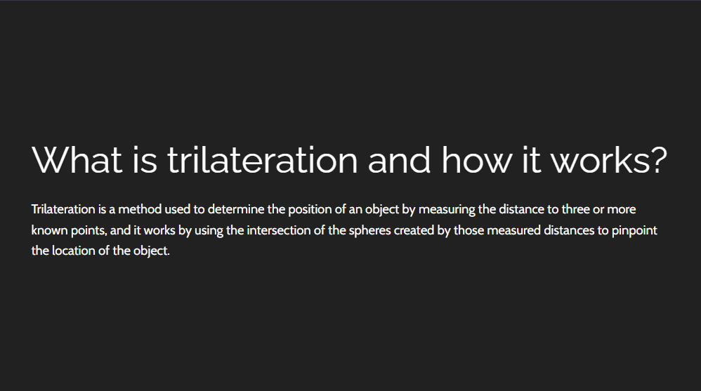

Slide 7
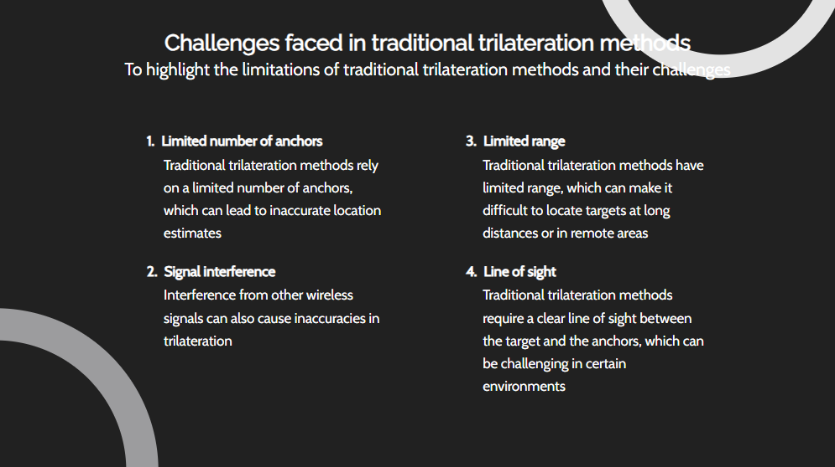

Slide 8
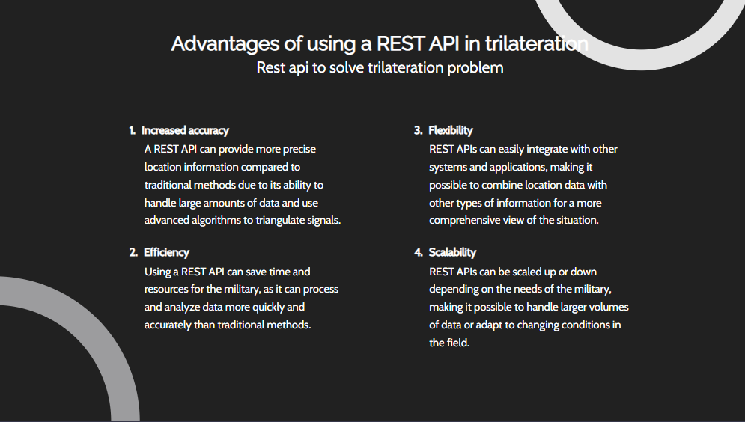

Slide 9
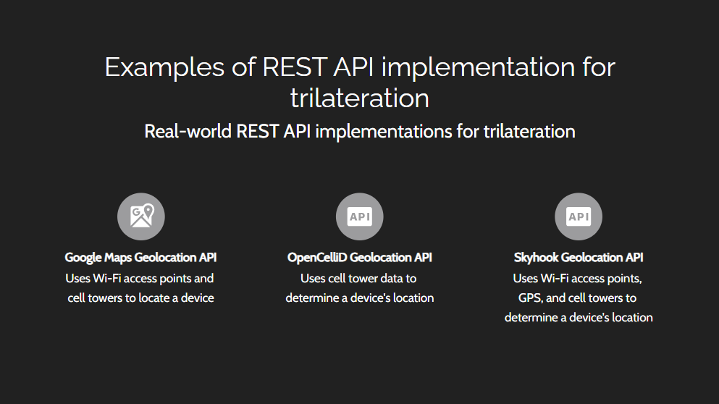

Slide 10


Slide 11
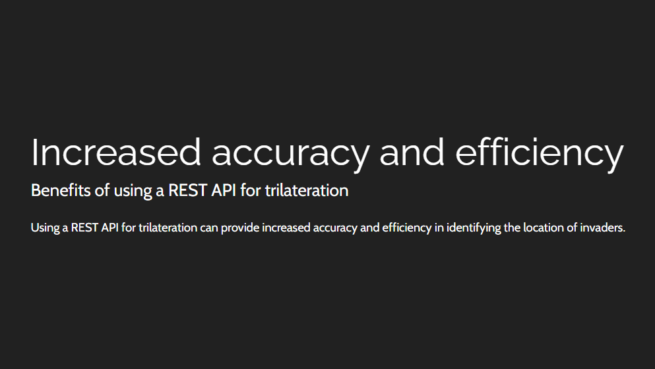

Slide 12
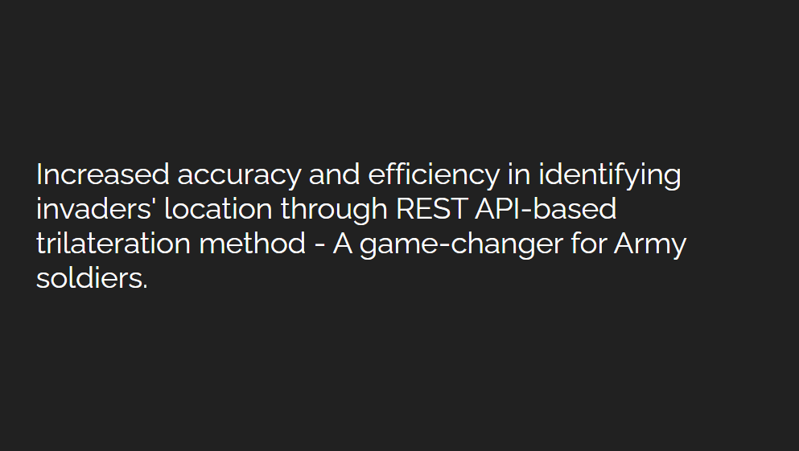

Slide 13


Slide 14
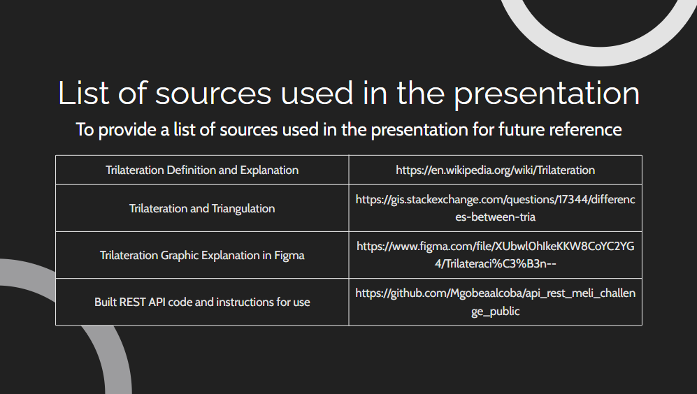

Trilateration Definition and Explanation | https://en.wikipedia.org/wiki/Trilateration
Trilateration and Triangulation | https://gis.stackexchange.com/questions/17344/differences-between-tria
Trilateration Graphic Explanation in Figma | https://www.figma.com/file/XUbwl0hIkeKKW8CoYC2YG4/Trilateraci%C3%B3n--
Built REST API code and instructions for use | https://github.com/Mgobeaalcoba/api_rest_meli_challenge_public

